Slide 1
HUMAN ACTIVITY RECOGNITION-VISION BASED APPROACH
PREDENTED BY:
2010030512_L.Keerthana
2010030517_M.Manideepa
2010030526_D.Dedeepya
2010030530_K.Sriteja
GUIDED BY:
DR.ARPITA GUPTHA

Slide 2
OUTLINE
FLOW DIAGRAM
IMPLEMENTATION CODE
TECHNIQUES

Slide 3
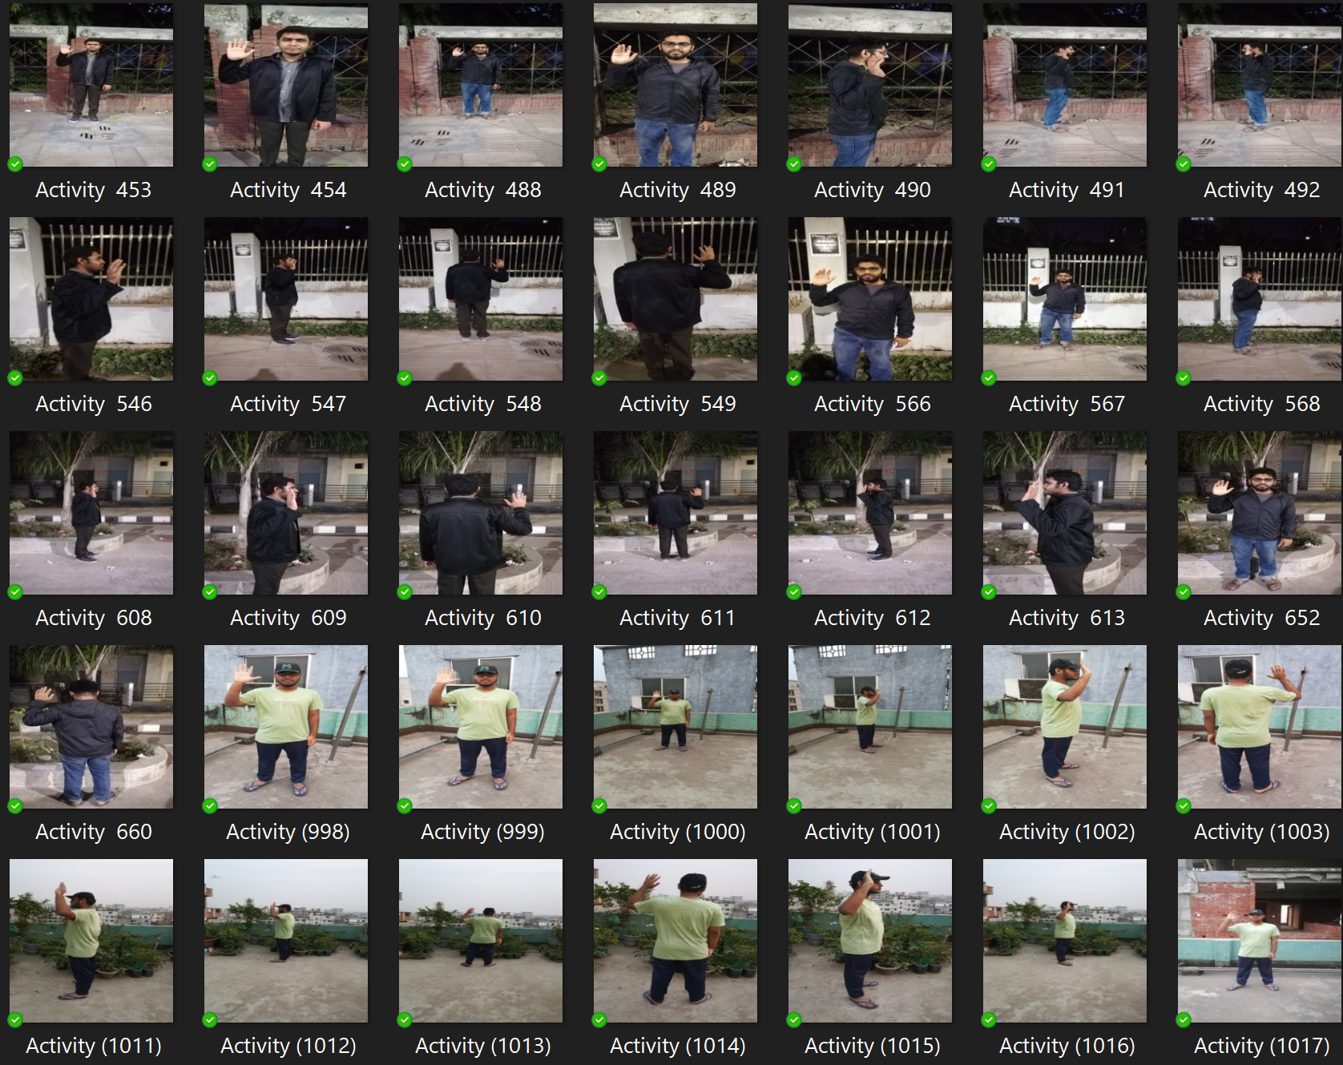
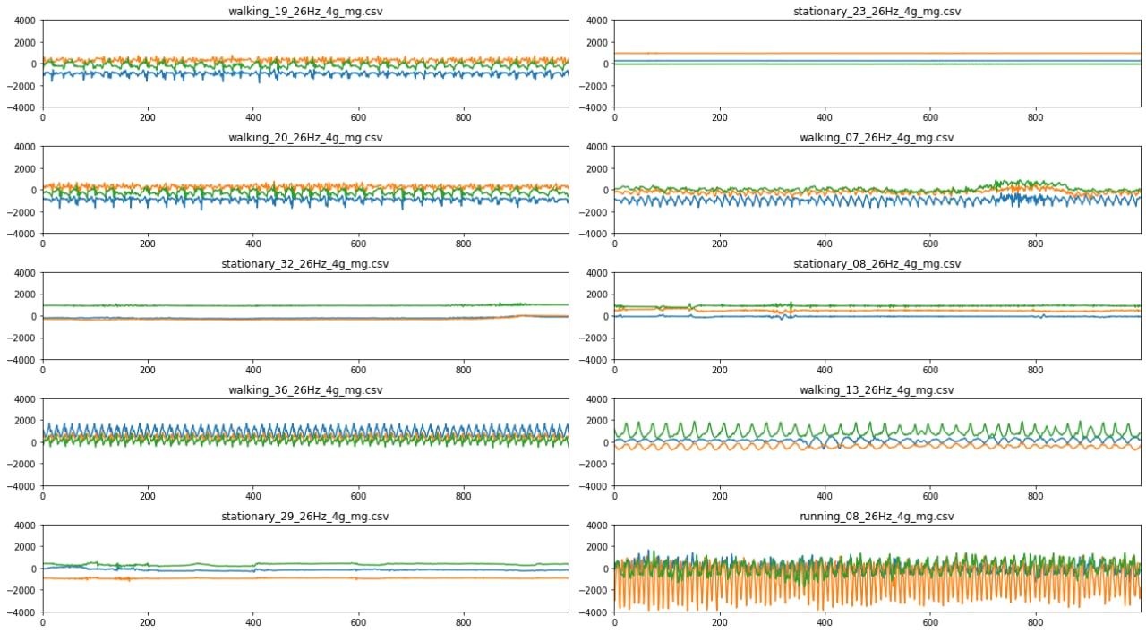
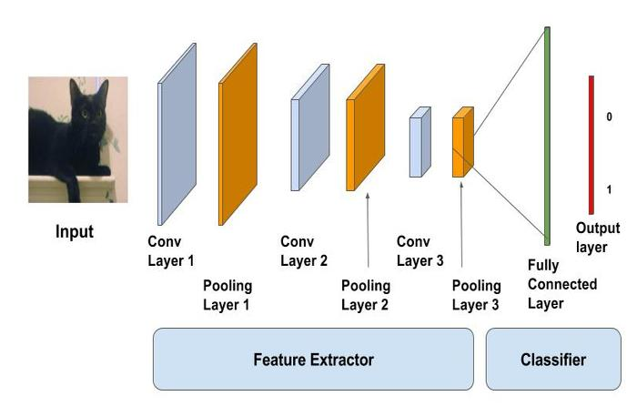
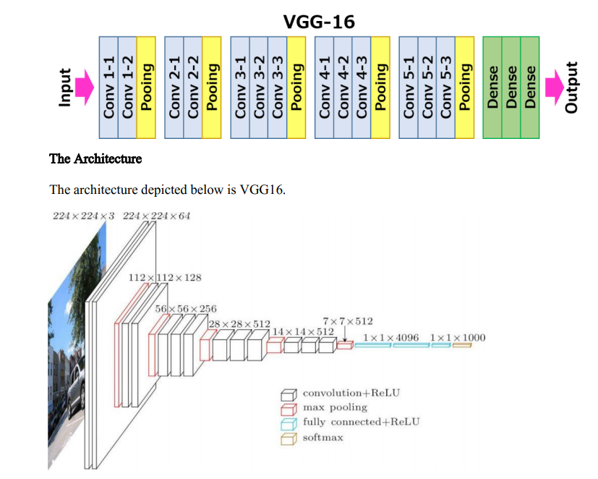
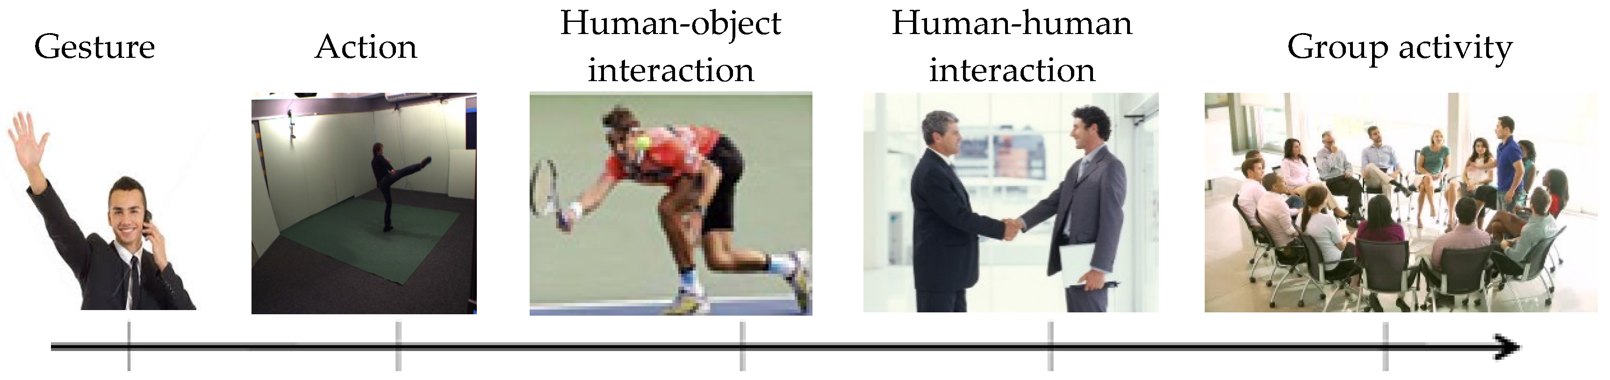
Flow Chart
CNN Model it takes in an input image, assign importance (learnable weights and biases) to various aspects/objects in the image and be able to differentiate one from the other.
DATASET
DATAPREPROCESSING
is done by noise reduction and segmentation
VGG16 is a simple and widely used Convolutional Neural Network (CNN) Architecture used for ImageNet, a large visual database project used in visual object recognition software research.
WORKING PROTOTYPE
MODEL EVALUATION

Slide 4
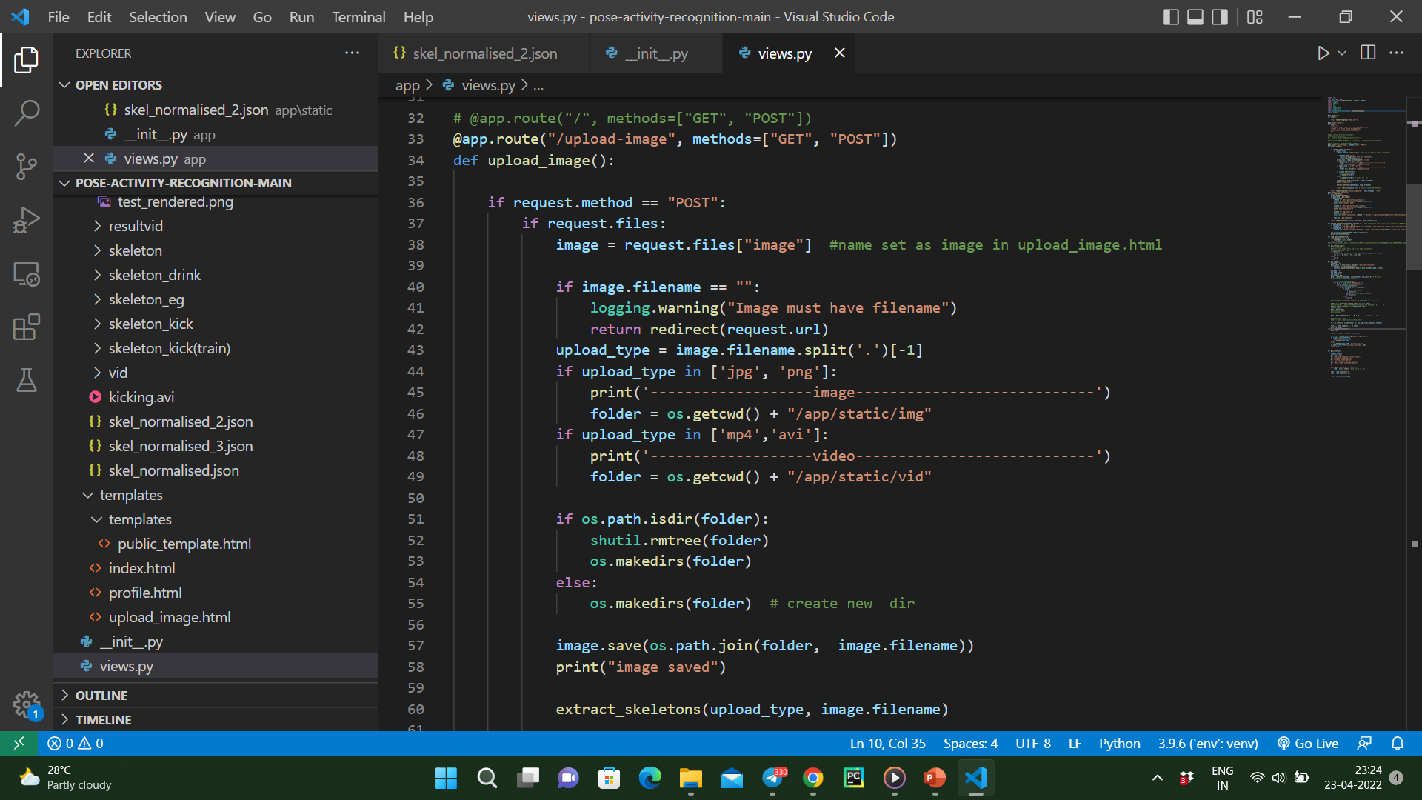
IMPLEMENTATION CODE

Slide 5
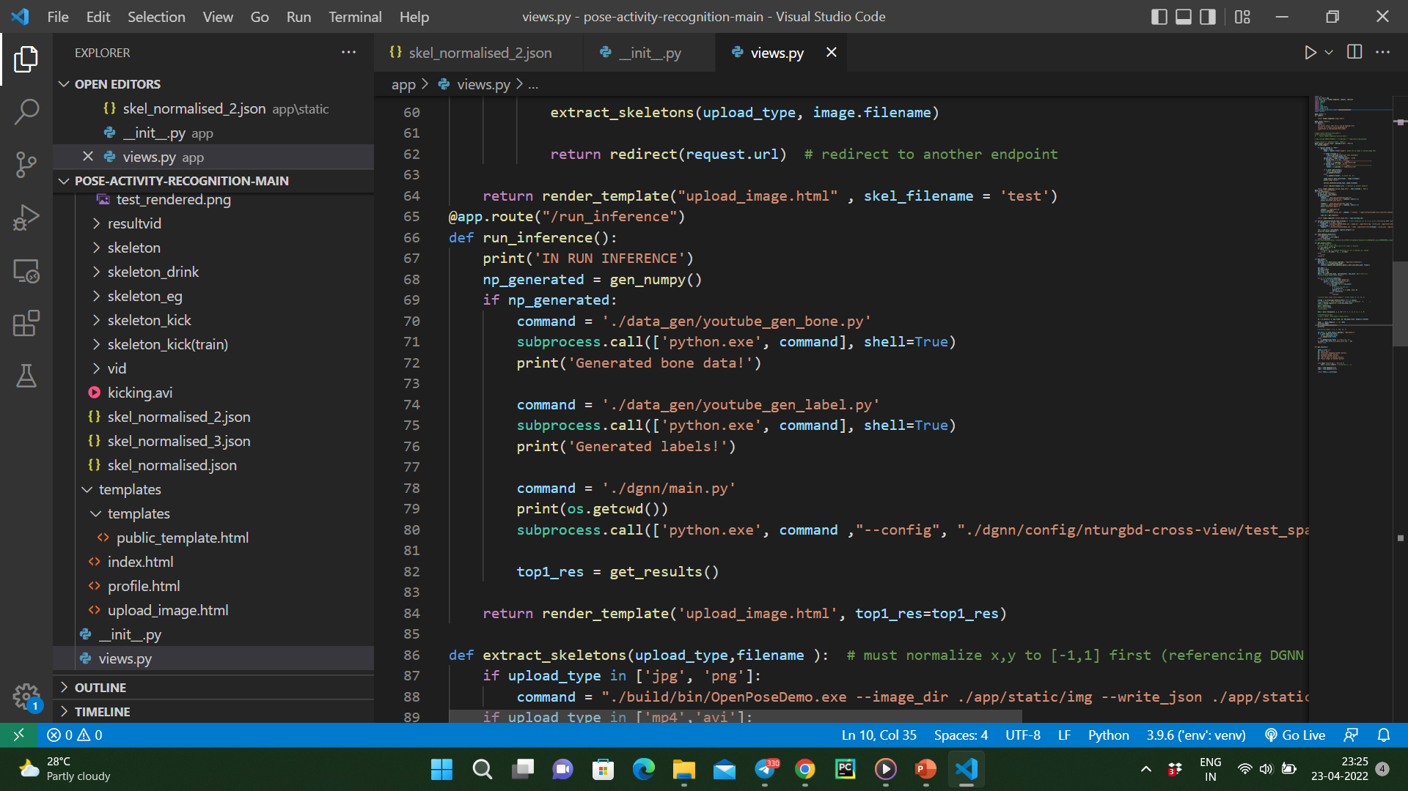

Slide 6
TECHNIQUES
Image Segmentation
Image segmentation is a method in which a digital image is broken down into various subgroups called Image segments which helps in reducing the complexity of the image to make further processing or analysis of the image simpler.
Segmentation in easy words is assigning labels to pixels. All picture elements or pixels belonging to the same category have a common label assigned to them.
For example: Let’s take a problem where the picture has to be provided as input for object detection. Rather than processing the whole image, the detector can be inputted with a region selected by a segmentation algorithm. This will prevent the detector from processing the whole image thereby reducing inference time.

